Slide 1
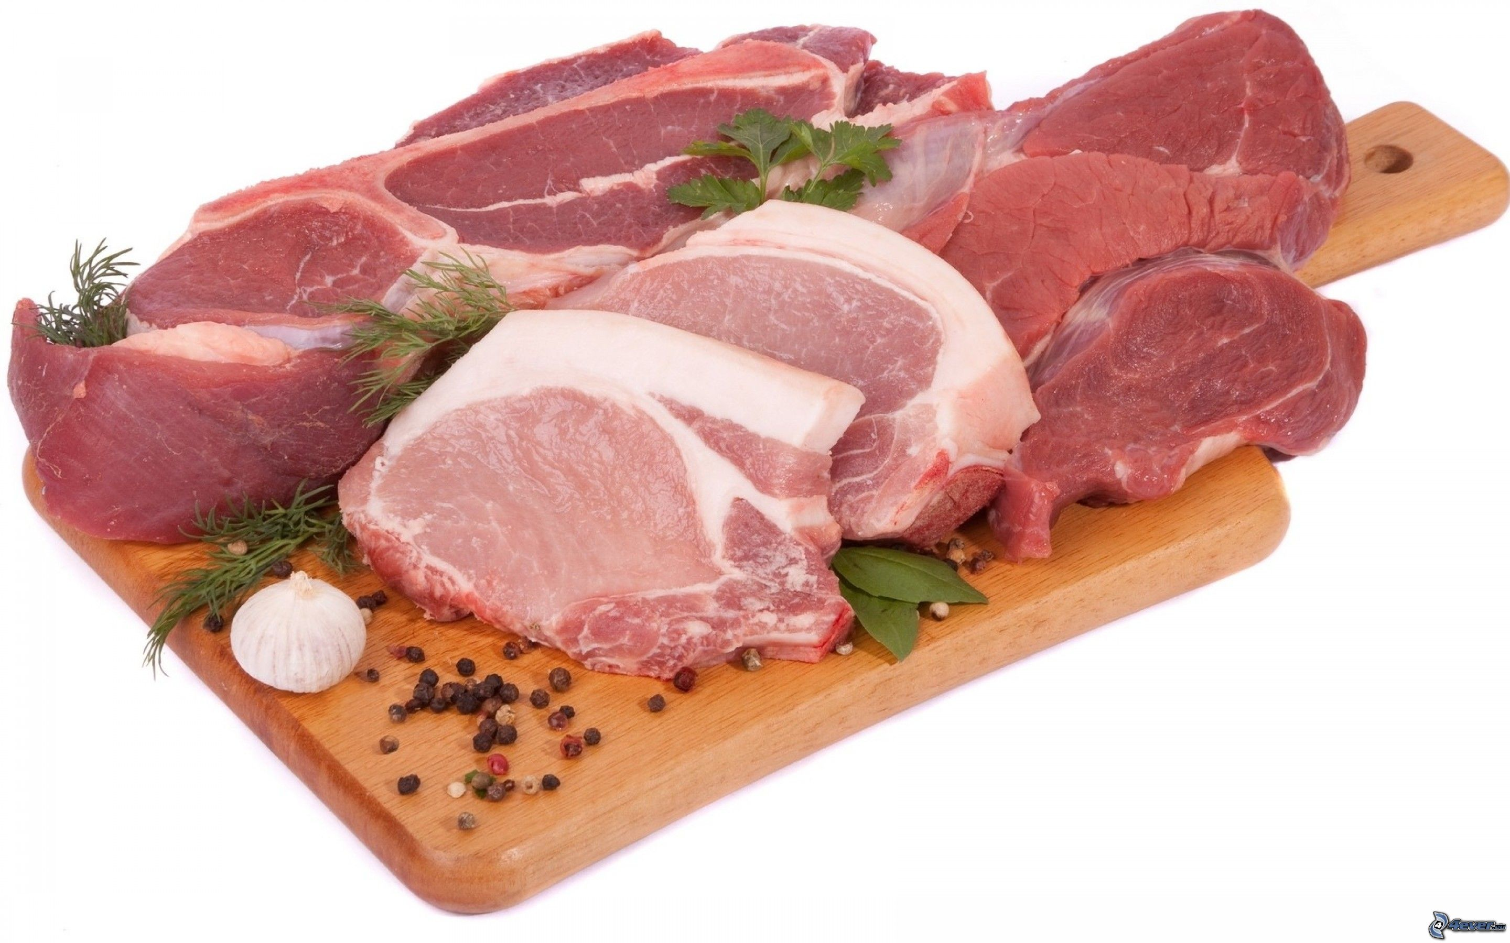
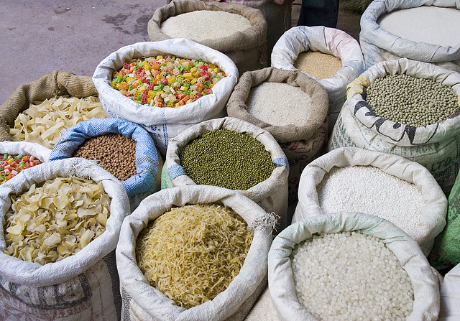
“Trial by Diet” in
Daniel chapter 1 by
Richard Dargie
June 2019

Slide 2
Introduction
The 2 previous presentations examined the structure of Daniel’s prophecy and the history of events that form the background to the words of his prophecy.
In this and following presentations we will look at the 12 chapters that comprise this most fascinating prophecy.
In presentation no. 1 we learned how chapters 1-6 comprised “court tales” and chapters 7-12 “apocalyptic prophecies”.
Although these chapters differ markedly in tone and content, the 2 aspects of the prophecy are not separate and unrelated to each other. Remember the number “62” occurs in both court tales and apocalyptic prophecy. [see next slide as a reminder]

Slide 3
Theme patterns in Daniel – Scenario 2 (ch 1-12)
chapter | Kings in chapter (s) | Themes which repeat A (demise), B (trial), C (vision), designations
1 Hebrew | Nebuchadnezzar - Cyrus | Demise of Judah Trial by diet | Temple vessels removed
2-5 Hebrew -Aramaic | Nebuchadnezzar – Belshazzar | C. Vision of 4 empires (ch 2) Nebuchadnezzar’s dream B. Trial by fire (ch 3) S, M, & A) A. Demise of Babylon (ch 4/5) (62 years) | Temple burned Vessels defiled
6 Aramaic | Darius- Cyrus | B. Trial of Daniel in Persia (Lion’s den) | Temple fortunes restored?
7-9 Aramaic -Hebrew | Belshazzar - Darius | C. Vision of 4 empires (ch 7) wild beasts Demise of Persia rise of Greece (ch 8) beasts Trial of God’s people in the land (ch 9) 70x7 (62 weeks) | Temple desecrated
10-12 Hebrew | Cyrus - Darius | C. 21 year delay explained to Daniel (ch 10) Demise of King of the North in Israel (ch 11) Trial of God’s people [& conclusion of all matters] (ch12) | True Temple revealed = resurrected saints

Slide 4
Daniel chapter 1: Trial by diet
The opening chapter of Daniel can be summarised as follows :-
  Nebuchadnezzar besieged Jerusalem in the 3rd year of Jehoiakim (605 bc). God delivered Jehoiakim into Nebuchadnezzar’s hand and part of the Temple vessels were taken to Babylon.
  Nebuchadnezzar instructed his master of eunuchs Ashpenaz to select young men from the royal household who would undergo a 3 year course of instruction in the wisdom of the Chaldeans.
  Daniel and his three friends were carried away to Babylon at this time (context seems to infer this) and undertook this 3 year course of instruction (at which they excelled). On completion they were presented to Nebuchadnezzar
  Early in their captivity, they requested that they should be allowed to eat a vegetarian diet, rather than the meat based diet required by Nebuchadnezzar – this was for a number of reasons, one of which was observance of the Law of Moses
  Following a successful 10 day trial of a water and pulse diet, their request was approved and it is apparent from the text that throughout the 3 years period of instruction, Daniel and his three friends were exemplary students and were blessed by God
  Finally, we are told that Daniel continued until the 1st year of Cyrus (539 bc, i.e. 1st year Cyrus ruled Babylon) - a prophetic term of 66 years

Slide 5
“In the third year of the reign of Jehoiakim king of Judah came Nebuchadnezzar king of Babylon unto Jerusalem, and besieged it”. (Dan 1.1 KJV)
Nebuchadnezzar’s siege of Jerusalem must have occurred shortly after Nebuchadnezzar defeated Pharaoh Necho at Carchemish in 605 bc
There is no confirmation of this in any secular record
The Bible acts as the only extant historical record

Slide 6
Daniel & his friends – eunuchs or not?
Daniel and his friends were of royal descent and young men [probably in their teens]
It is often inferred that they were castrated, but we also read that they were “without blemish” [Dan 1.4] i.e. complete or whole, so evidence is not totally conclusive here for castration.
The prophet Isaiah warned Hezekiah that some of his sons would become eunuchs in the palace of the King of Babylon [Is 39.7] as some almost certainly were – was this the fate of Daniel and his three friends?
N.B. - If Daniel and his three friends were castrated, this would exclude them from the congregation of the Lord [Deut 23.1]

Slide 7
Trial by diet -(favour & goodwill)
Daniel’s refusal to eat the diet he was required to partake of in Babylon is usually ascribed to his desire to adhere to the Mosaic code as a man of faith.
This was doubtless a strong motivation, but maybe it masks a deeper realisation in Daniel’s mind…… more than just pure Mosaic observance but loyalty to the covenant relationship established at Sinai.
Evidence for this assertion is in the text of Dan 1.9 “God had brought Daniel into the favour and goodwill of the chief of the Eunuchs”
It is clear that the chief of the Eunuchs is acting as God’s agent i.e. he is God’s instrument and his attitude to Daniel (favour & goodwill) reflects the divine attitude to Daniel.
Various lexicons have suggested that the name of the chief of the Eunuchs “Ashpenaz” means “I will make prominent the sprinkled” [see 3 of slide 9]

Slide 8
Trial by diet -(favour & goodwill) continued
The Hebrew phrase “favour and goodwill” is a relational phrase that describes God’s covenant love towards his people.
In this phrase covenant faithfulness & mercy [Hebrew (hesed) ] is combined with tender love [Hebrew (rahamim)].
The Hebrew rhm is derived from the Hebrew for womb where tender care for the unborn infant occurs and this stands as a metaphor for compassion and tender love.
Daniel, later to be addressed as “greatly beloved” in Dan 9.23, 10.11 and 10.19 is now the recipient of tender love and mercy from God via his agent “the chief eunuch”.
This demonstrates to Daniel that divine covenant faithfulness towards the Israelites has not been extinguished by their exile to pagan Babylon for their sinful & idolatrous ways – a crucial message to the young man Daniel as he faced a life of exile in a foreign & pagan land.

Slide 9
Trial by diet –Israelite & Judean Ancestry
Mention of the “children of Israel” [Dan 1.3] comes before mention of the “sons of Judah” [v6].This seems to suggest that the tribe of Judah is a subset of the larger covenant community “Israel”
The suggested key here is the ratification of the covenant relationship with Israel described in Exodus 24.
In Exodus 24 the nobles of Israel eat and drink with God & the covenant is ratified when the people are sprinkled with the blood of sacrifices made by the young men
Daniel 1 has numerous intertextual links with Exodus 24 particularly with the Septuagint version; e.g. the use of the Greek word for “princes” (RVM “nobles”) in Dan 1.3 is used for the first time in Ex 24
Similarly, the phrase “the children of Israel” is employed in Ex 24.11 and Dan1.3

Slide 10
Trial by diet –Israelite & Judean Ancestry continued
6. Whereas the young men of Israel offered sacrifices [Ex24.5] ; the young men of Daniel have “no blemish” [Dan 1.4]
7. This juxtaposition of ideas from Ex 24 with Daniel 1 suggests that Daniel and his three friends are the sacrifice.
8. N.B. This would be a contra argument re: Daniel & friends being eunuchs
9. The trials of these young men [here and in the following chapters] amply demonstrate their willingness to self sacrifice when their covenant faith was threatened
  Trial by diet – Daniel chapter 1
  Trial by fire – Daniel chapter 3.
  Trial by wild beast – Daniel chapter 6

Slide 11
Trial by diet –Whose table? Neb’s or God’s?
“But Daniel purposed in his heart that he would not defile himself with the portion of the king’s meat, nor with the wine which he drank: therefore he requested of the prince of the eunuchs that he might not defile himself” Dan 1.8
There were limits to the exiles desire to assimilate themselves into the way of life in Babylon.
They may well have appropriated the learning and culture of Babylon & achieved high office but the faithful refused to fully integrate, because they were still in covenant relationship with Yahweh and not dependent on man’s table.
The Israelites were already in table fellowship with God - their princes [nobles] of Israel shared a covenant meal with God and enjoyed “table fellowship” with him [Ex 24]
They had been sprinkled with the blood of the covenant and Daniel did not want to be dependent on the table of another king and pollute his inheritance

Slide 12
Trial by diet –Whose table? Neb’s or God’s? continued
5. Daniel chose “…life that both thou and thy seed might live [ Deut 30.19]
6. The “table” of the Lord is idiomatic for the sacrificial altar of the Lord and the term “table” is found in conjunction with pollute [or defile] three times in the Greek versions of the OT [Daniel 1.8 and Malachi 1.7 & 12]
7. Contrast Daniel’s example with that of the faithless king Jehoiachin who was restored to the table of the king of Babylon after languishing in prison for 37 years [Jer 52.31-34]
The Hebrew verb for defile or pollute [g’l] occurs eleven times in the OT. The Septuagint uses several different roots to render this term in the OT, but the most common is [alisgo] to pollute. This root only occurs once in the NT [ as a nom. Alisgema] in connection with the Jerusalem council letter to the believers in the ecclesia's instructing them to “abstain from pollution of idols” [Acts 15.20]

Slide 13
Trial by diet – the names of Daniel’s friends
Daniel means “ God is my judge”
The names of Daniel’s three friends reflect ongoing divine care:
Despite divine judgement Yahweh is :-
  gracious –(Hananiah) and helps- (Azariah) his people
  the only God who can deliver like this (Mishael)
Mishael (who is what God is) is a similar form to the name of the angel Michael (who is like God?)

Slide 14
Trial by diet- “days of awe”?
It is suggested that the ten day period of Daniel’s trial by diet is not randomly chosen but is based on the “days of awe”, the ten day period between the Jewish new year and the day of Atonement.
Within Jewish folklore this period is often regarded as a time of probation during which the fate of the righteous and the wicked were sealed
At the end of the period the “books” were opened and judgement occurred on the great day of atonement
As Daniel is concerned with end time atonement [Dan 9.24] and with the opening of the books [Dan 7.10] it seems reasonable to assume that the ten day trial reflects this significant period
In other words the exile community was on probation until the great day of judgement – reflected in the meaning of Daniel’s name (God is my judge)

Slide 15
NT use of Daniel
Many of the themes in Daniel 1 are echoed in Acts chapter 6
  The diet of the Greek widows serving tables
  The spirit that animated Stephen in terms similar to Daniel (Acts 6.10)
    “they were not able to resist the wisdom and the spirit by which he (Stephen) spoke”
    “And in all matters of wisdom and understanding …ten times better” (Dan1.20) plus “The spirit of the holy gods is in thee” (Dan 4.18)
  The description of Daniel’s countenance is reminiscent of Stephen’s visage
    “And at the end of ten days their features appeared better and fatter in flesh than all the young men who ate the portion of the king’s delicacies” (Dan 1.15)
    “And all who sat in the council looking steadfastly at him saw his face as the face of an angel” (Acts 6.15)
  The narrative in Acts seeks to emphasise that Stephen refused the “table” of Judaism, because, like Daniel, Stephen preferred the table of the Lord
“We have an altar from which those who serve the tabernacle have no right to eat” [Heb 13.10]

Slide 16
Acknowledgements
For a more detailed discussion of these matters please refer to “God is Judge” A Commentary on the book of Daniel by Bro. P Wyns Chapter 2 (pp27-33 (Biblaridion Media ABN48639769820) ISBN 978-0-9870808-0-6
Map courtesy of the Christadelphian
All references /quotes from the KJV

